Slide 1

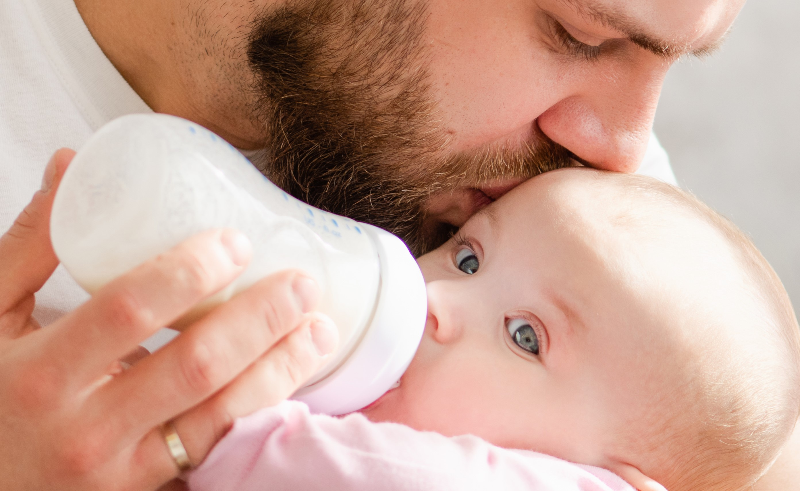
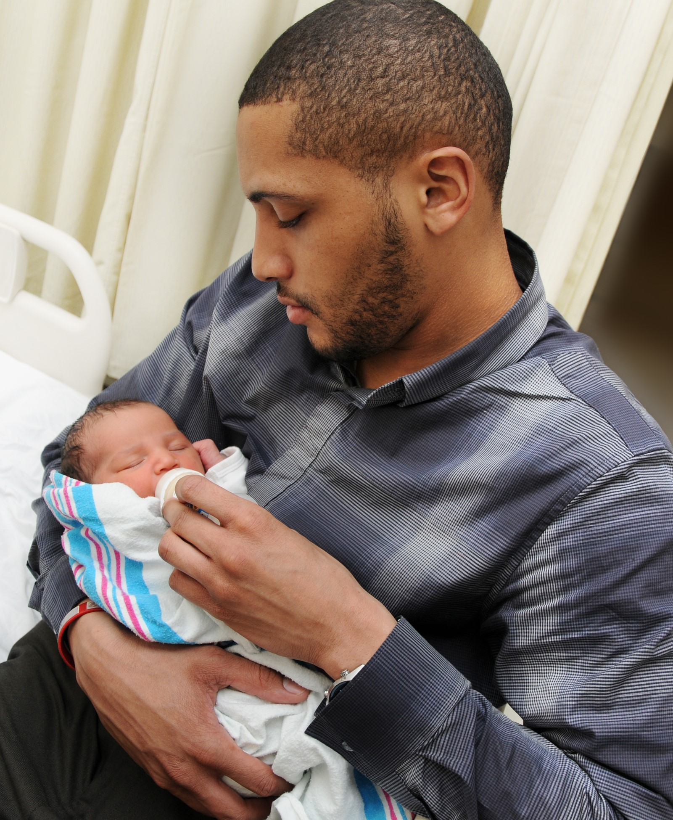
Bottle feeding your baby
Cathy Sage IBCLC

Slide 2
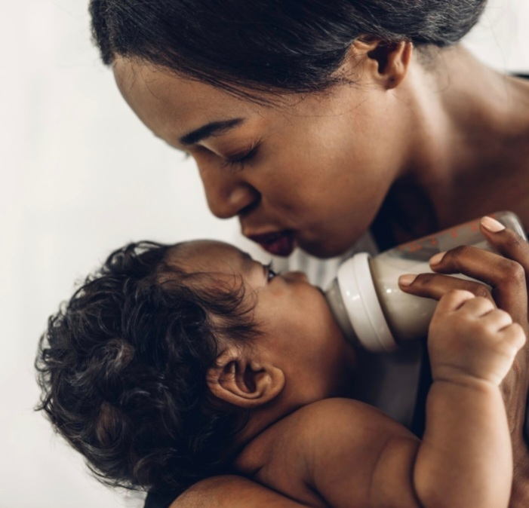
Key questions
Benefits of bottle feeding
How to select bottles - teat types, flow rates, funky features
Choosing formula milk
Preparing the bottles – what kit do we need?
How to bottle feed – positions, pace, winding
Figuring out volumes and routines
Overcoming bottle problems – allergy, refusal, aversion

Slide 3
Benefits of bottle feeding
Lovely for your baby
You, friends and family adore the bonding time
Predictability around times and volumes (sometimes!)
Rest
Formula is nutritionally complete, babies thrive on it

Slide 4
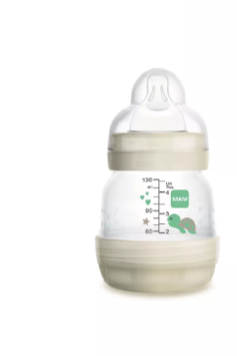
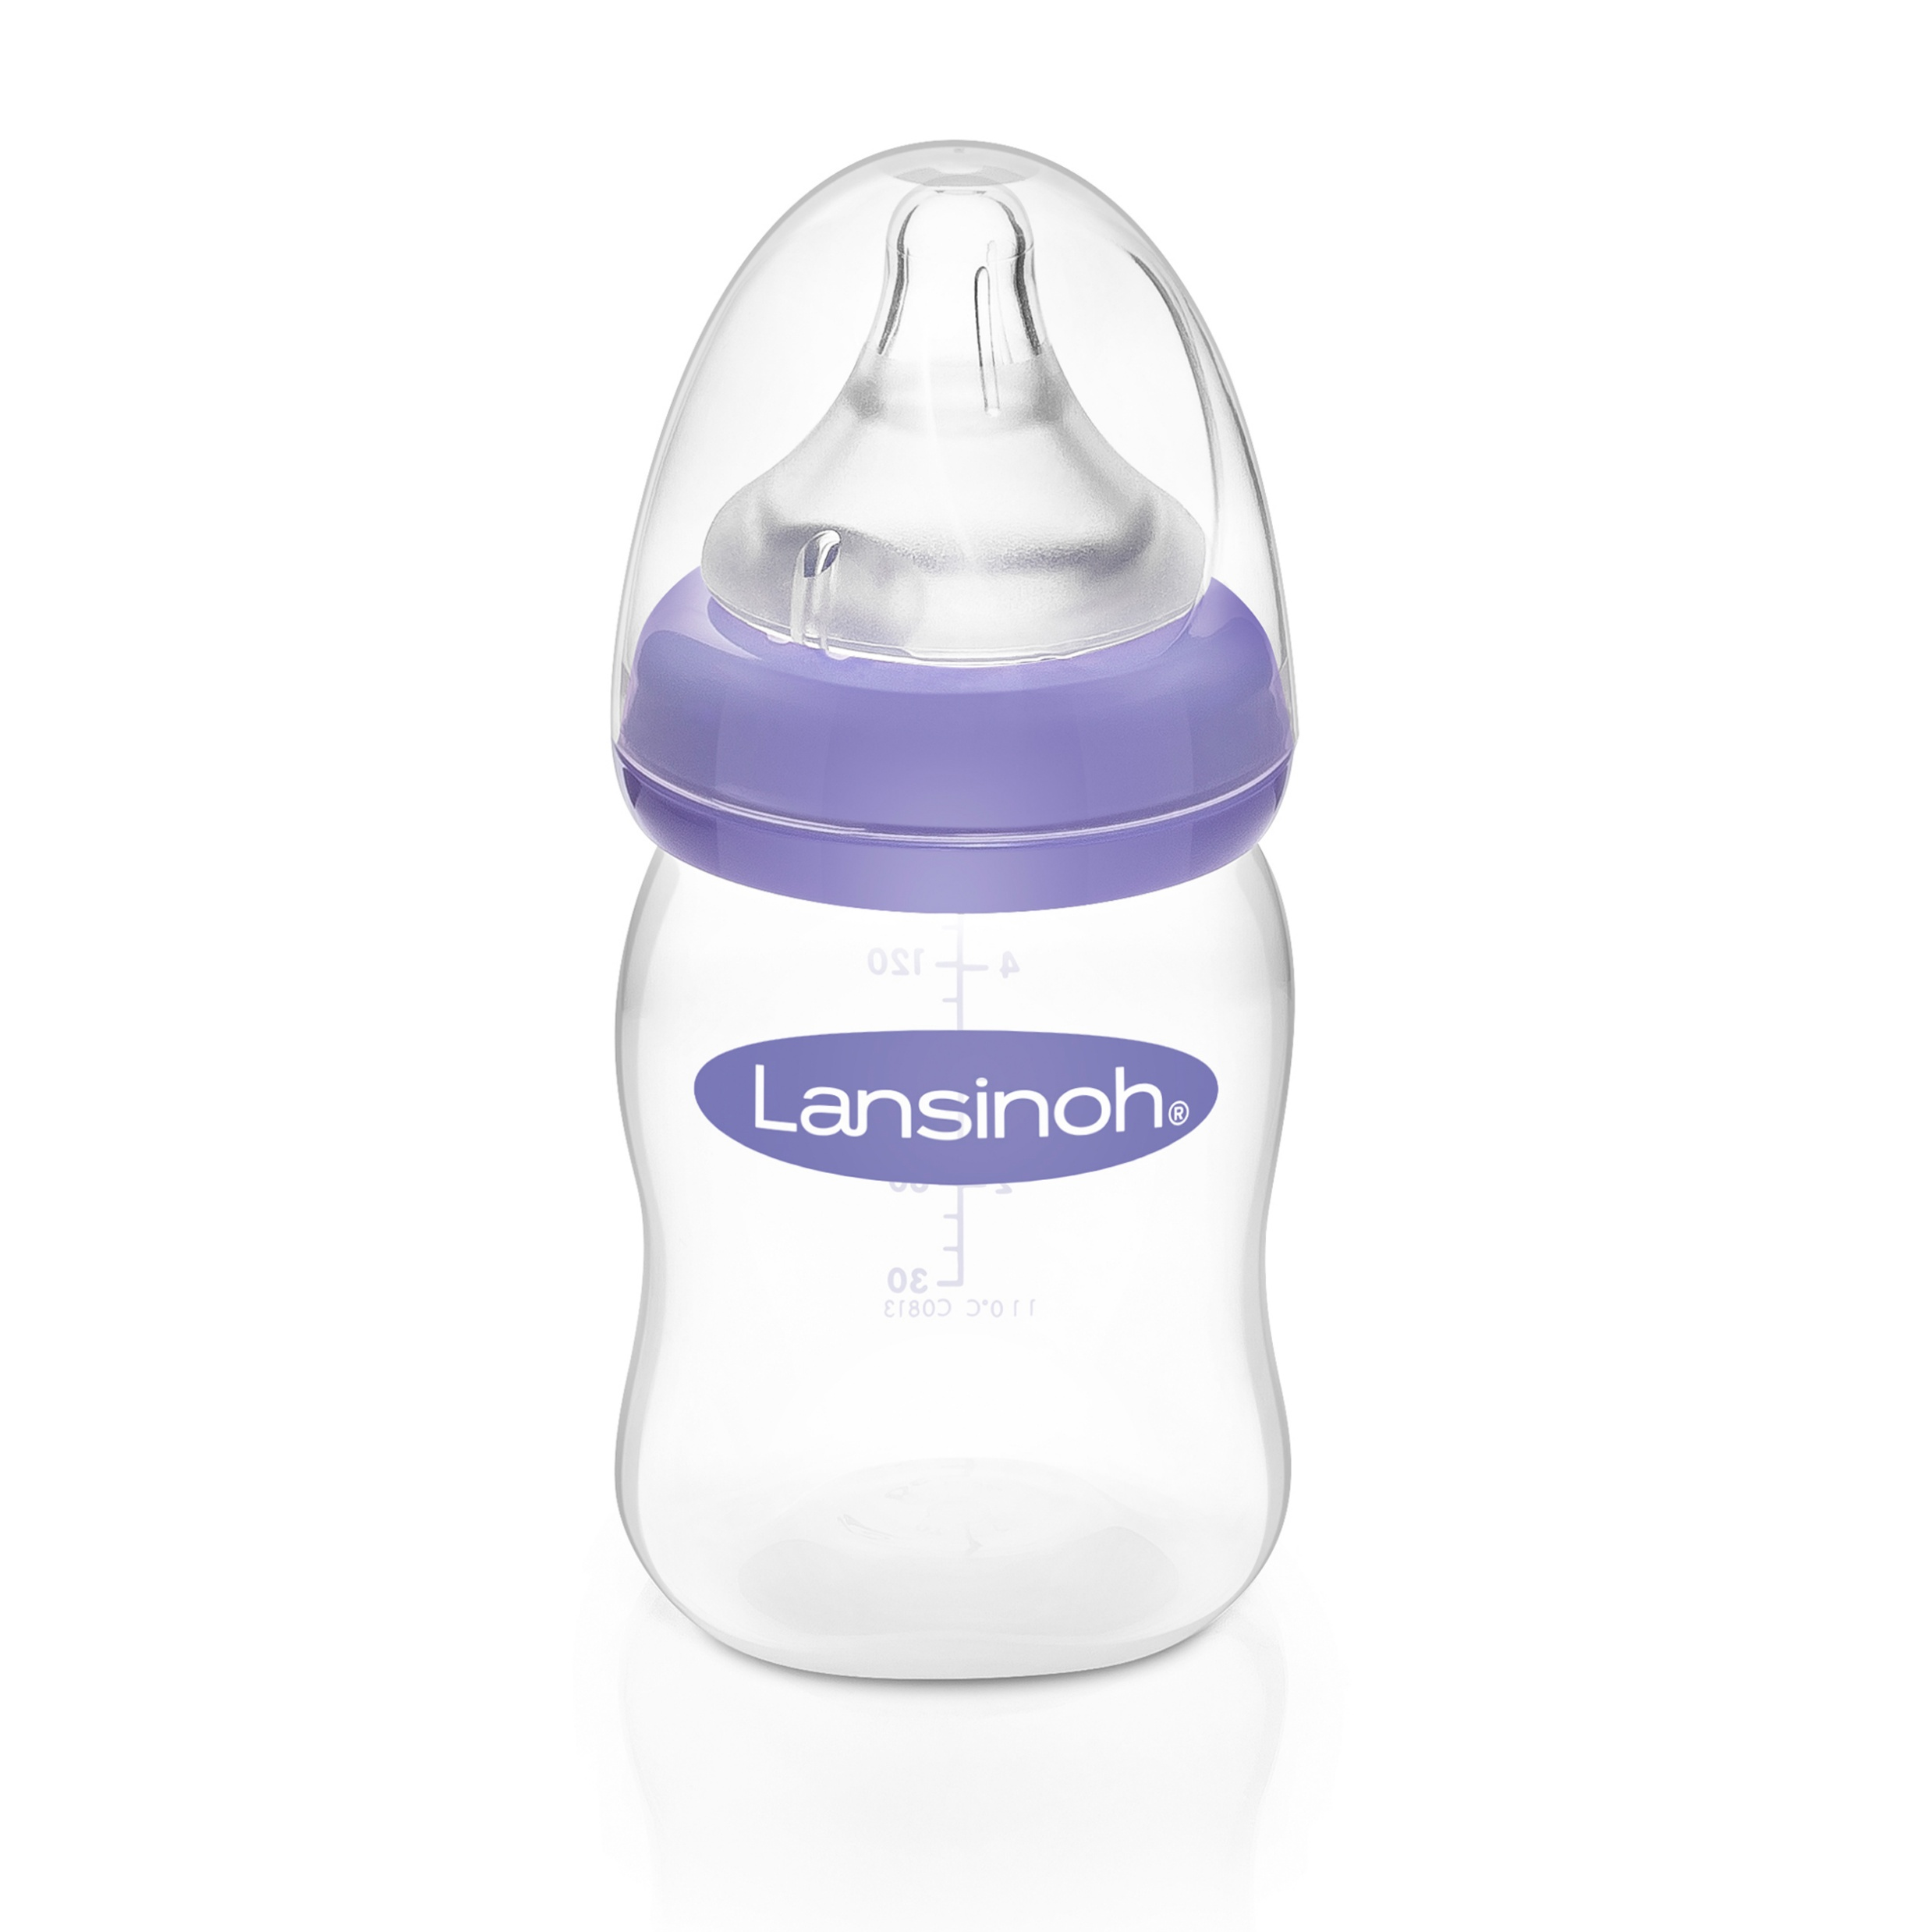
Selecting a bottle
Teat shape: conical is good
Flow rate: suitable for your baby’s age and stage
Latex vs silicone: up to you
Glass vs silicone vs plastic: your choice, microplastic and waste issue
Anti-colic, reflux, spit up: no independent evidence
How you can sterilise them: some can go alone in the microwave
Boob shaped/coloured: not necessary

Slide 5
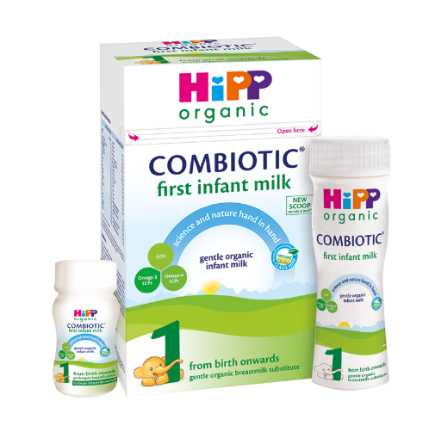
Choosing formula
Which number? Number one from birth to 12 m
Which brand? Any
Ready to feed or powder? Up to you, could use both
Halal, vegetarian, vegan, organic, home-made? Definitely not home made. Check First Steps Nutrition
Anti colic/comfort milks? Not recommended
Specialist milks e.g. lactose free, hydrolyzed? No. The GP will prescribe if necessary.
Cow or goat milk? No difference in allergies or comfort
How would I know if my baby was allergic to it? Clinical signs, ask your GP
Can I switch brands? Yes

Slide 6

Evidence based information

Slide 7
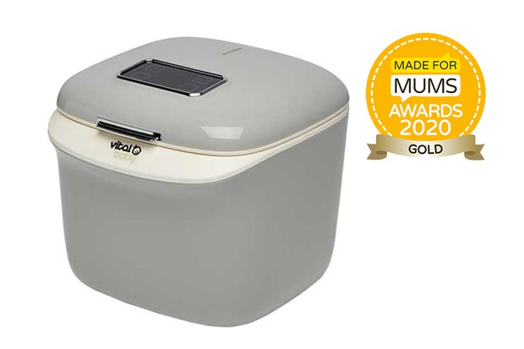
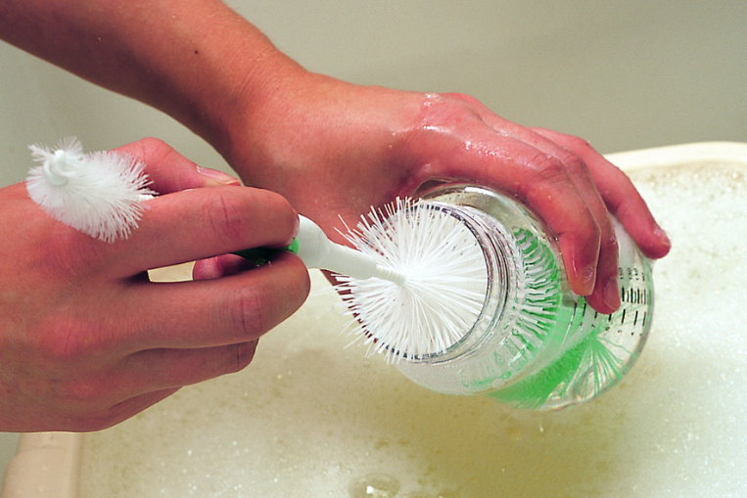
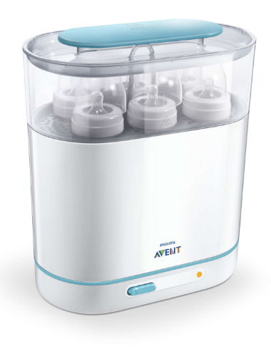
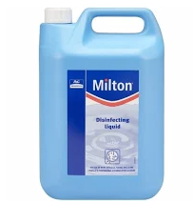
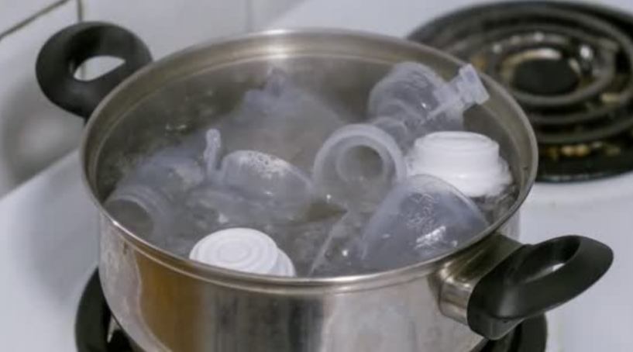
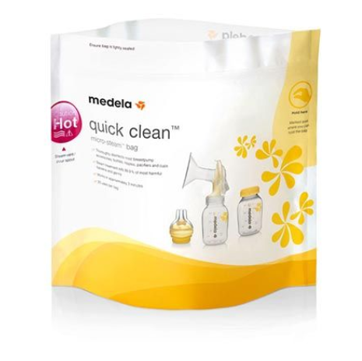
How do you wash and sterilise bottles?

Slide 8
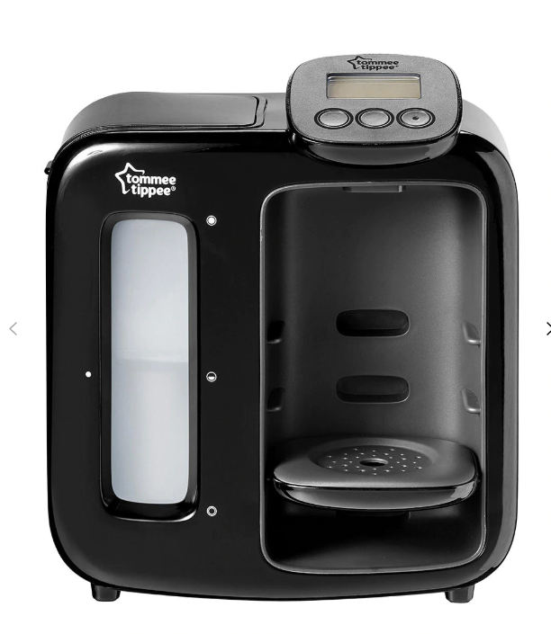
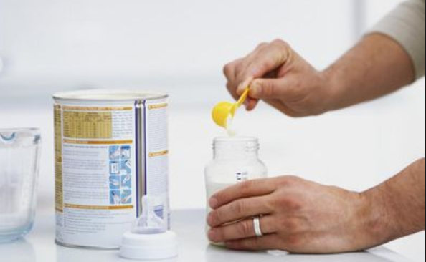
Preparing the bottles
How do I prepare it safely? Read the instructions carefully
Do I have to warm it? If so, how? Stand in warm water if you like to get it to body temp (37 degrees). Some babies don’t care about cold milk
Are formula preparation machines safe and worth it? NHS does not recommend them. Make sure they make the formula over 70 degrees. Extra care with premature or vulnerable babies
Do I need kit to take out the bubbles? No
If I have made formula, how do I store it? In the back of the fridge for up to 24 hours
How do I formula feed on the go? Ready to feed bottle or flask of hot water and powder to mix, or take prepared powdered formula in cool bag and use ASAP
If my baby has started a bottle, how long can I keep it? 1 hour

Slide 9

How to bottle feed
Head, back and neck in a line, arms in front, feet on something
Elevated side lying
Good latch on the bottle
Paced and responsive feeding
Look for signs of comfort vs stress

Slide 10
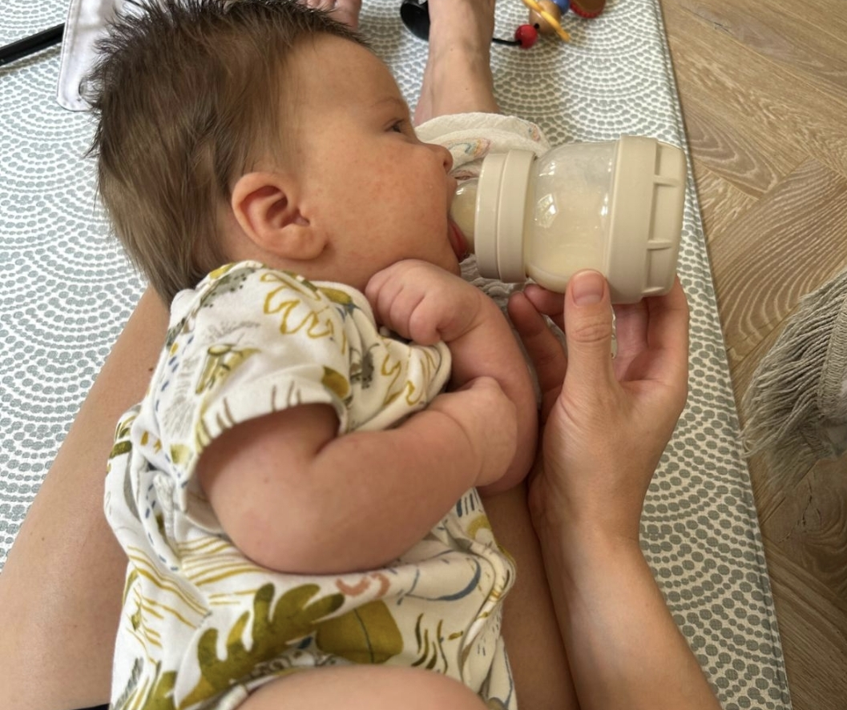
Elevated side lying
Baby lies with their head on your bent knees or a pillow
Head slightly above their bum

Slide 11
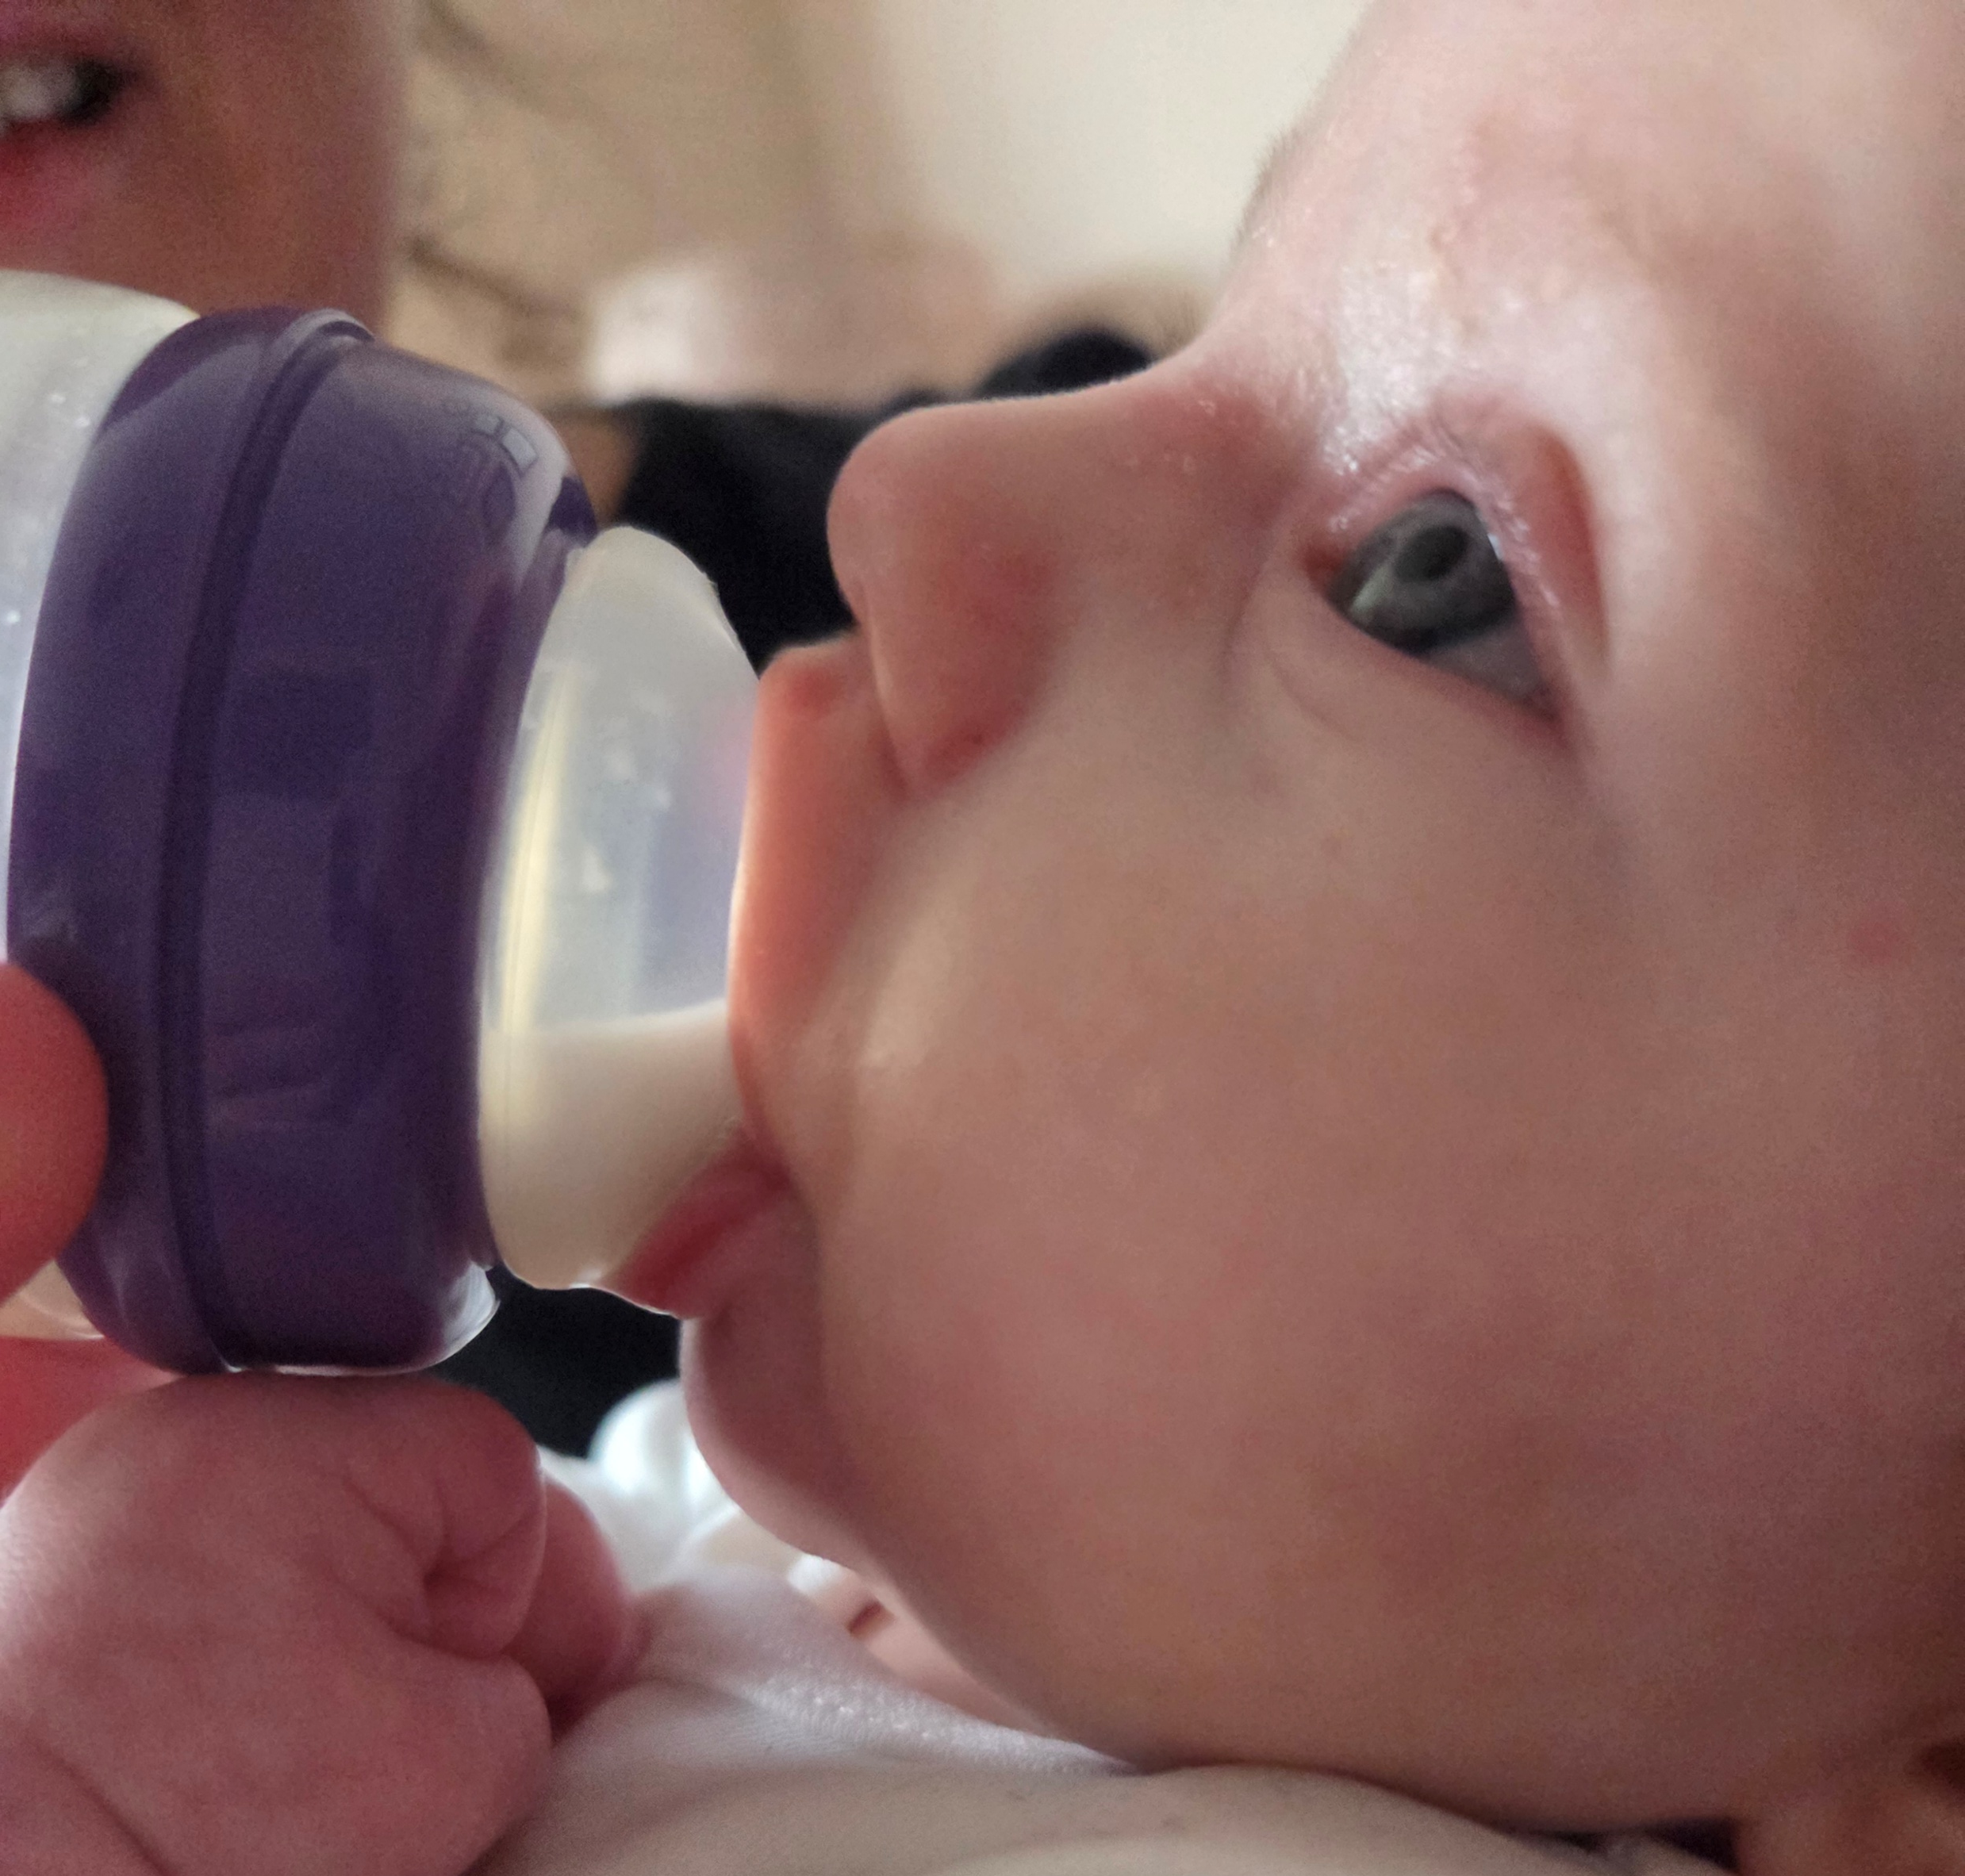
A good latch on a bottle
Rolled out lips
Seal all the way around

Slide 12
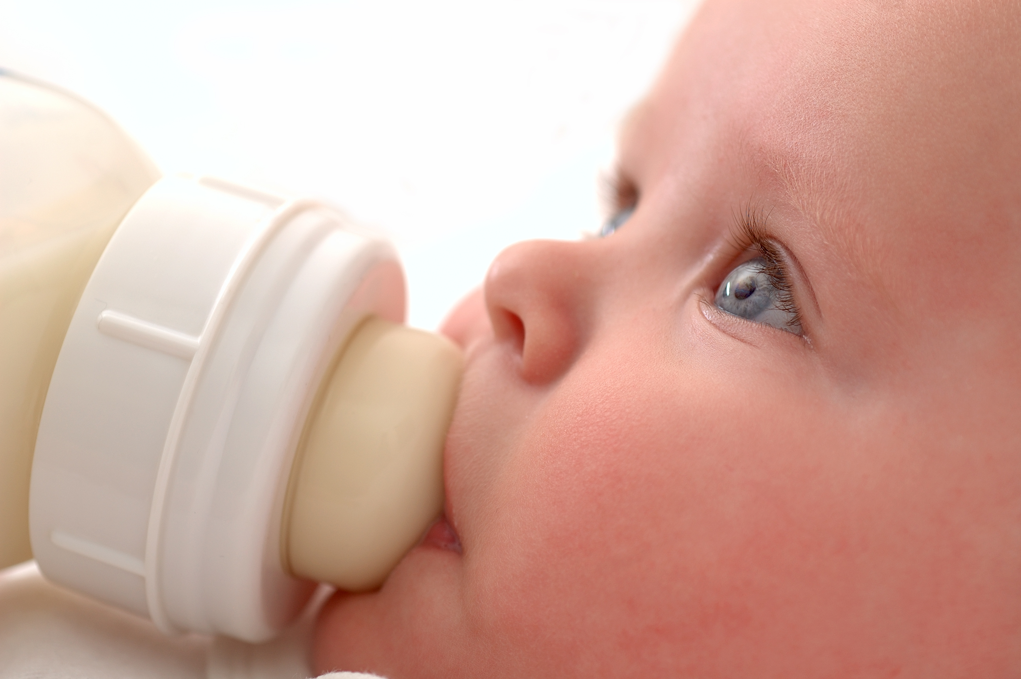
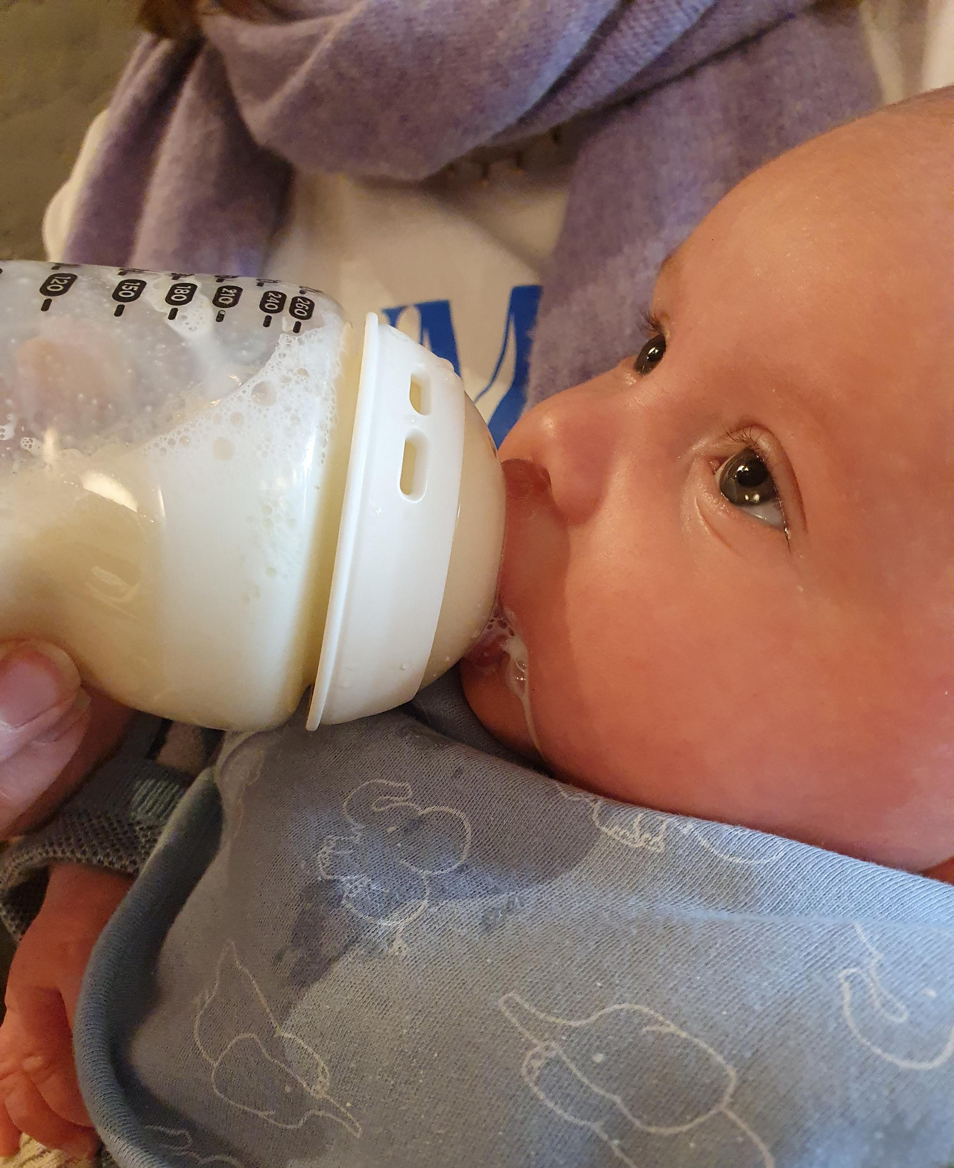
A bad latch on the bottle

Slide 13
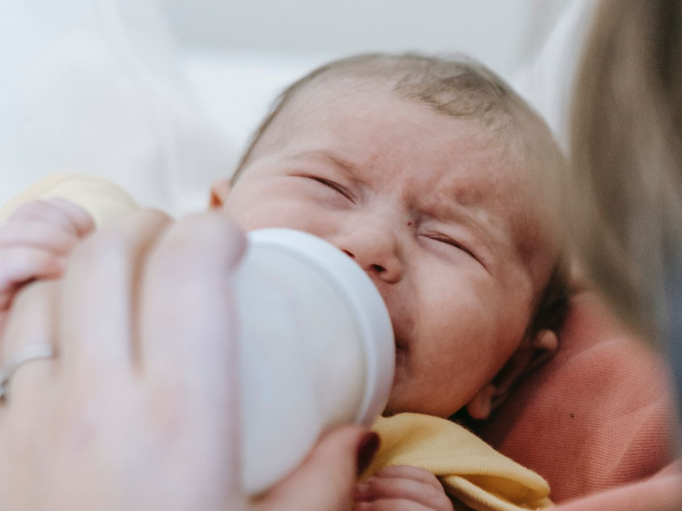
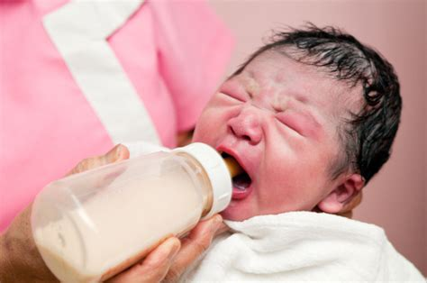
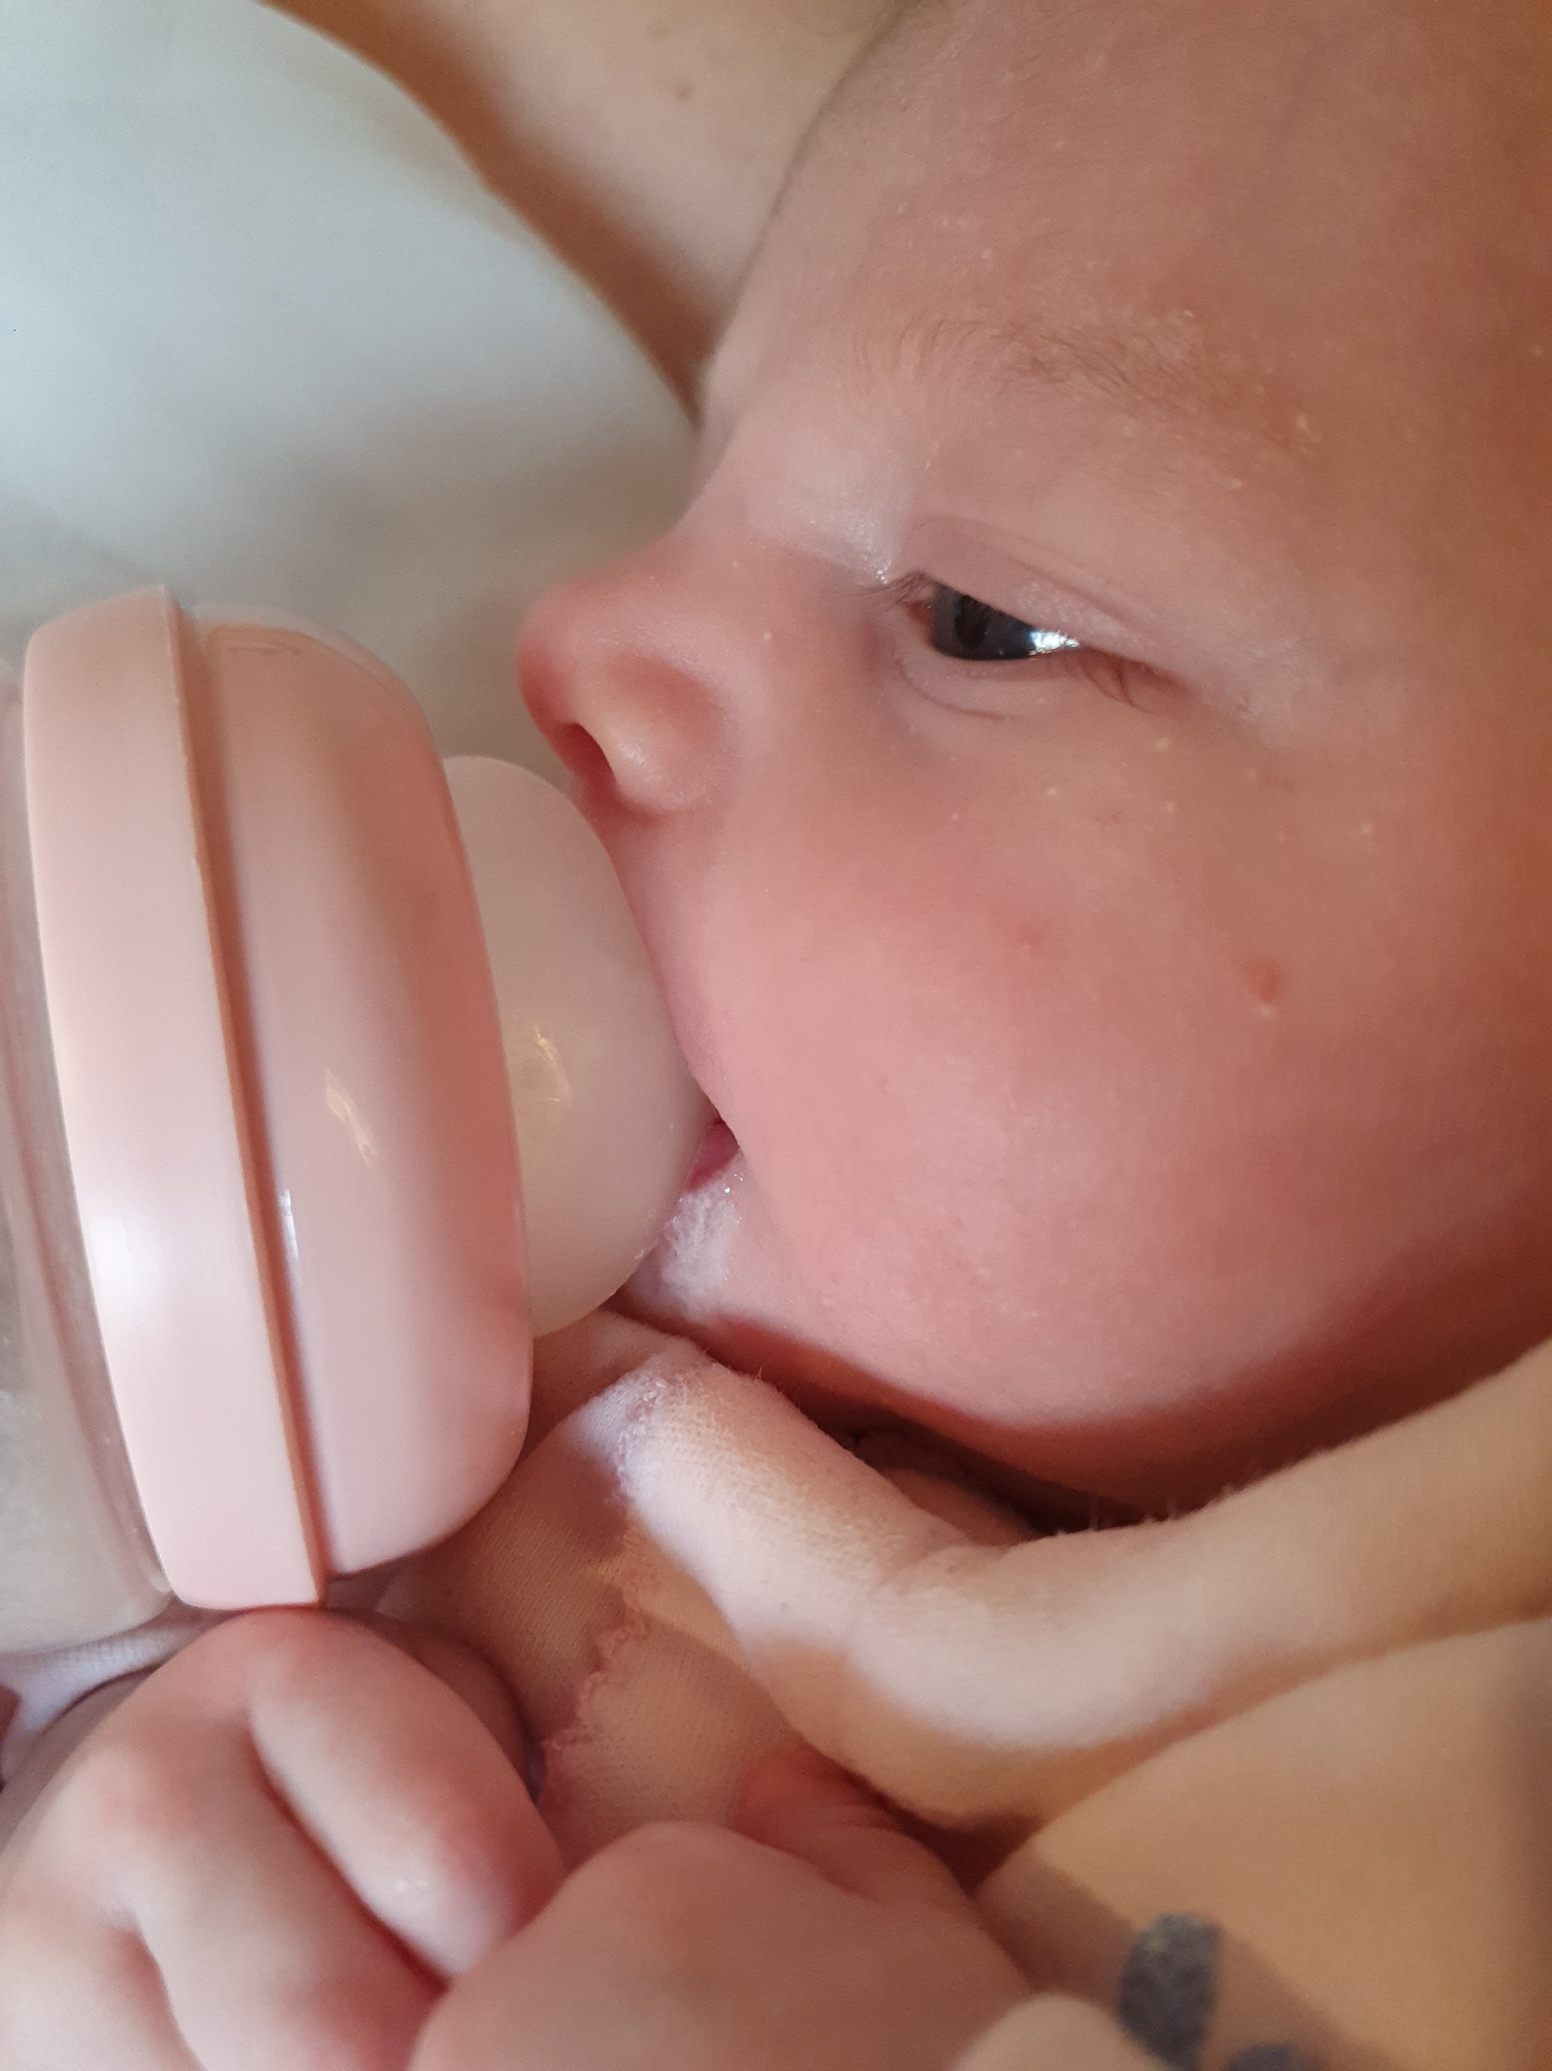
Signs they need a break
Coughing, gagging
Pulling back
Crying or flailing
Pushing milk out of the sides
If this keeps happening, change the bottle

Slide 14

Winding
If they are uncomfortable
If you learn your baby needs it
More crying leads to more wind. No need to interrupt a feed to wind “just in case” if it makes your baby very sad or cross

Slide 15

Volumes and routines
First week 8+ feeds in 24 hours
10 mls day one per feed, 20mls day two etc
150-200 mls per kilo of baby in 24 hours 1 week to 1 month
900mls ish in 24 hours 1-6 m
Read your baby not the book
Be responsive to their cues of hunger (smacking lips, rooting, crying) and being full (relaxed, closed mouth, open hands)

Slide 16
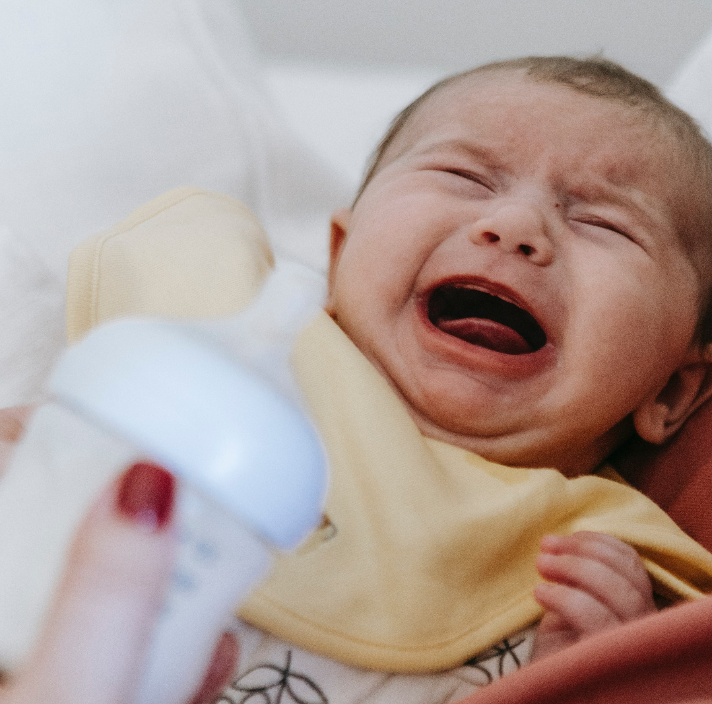
Bottle refusal and aversion
Refusal – plays with bottle in the mouth, pushes it around, might get some accidentally, eventually cries
Aversion – signs of distress when sees the bottle or held in position, very stressful feeds, will often only feed when asleep
Reach out for specialist help

Slide 17
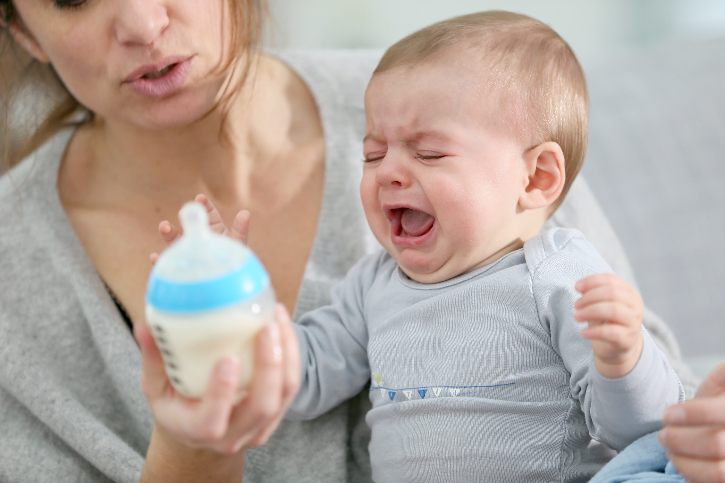
Signs of allergy or reflux
See your GP for a proper diagnosis
Allergy signs: hives, swelling of face, blood in poo, lots of mucus in nappies, explosive green frothy poos every feed
Reflux signs: very unhappy baby, losing two centiles in weight charts due to refusal to feed or lots of vomit

Slide 18
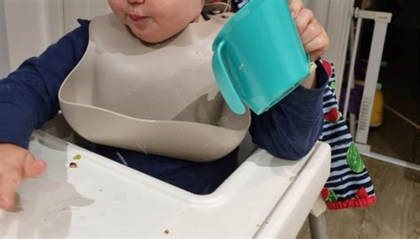
Options for older babies
Open cups (from birth if necessary)
Sippy cups from 4 m
Straw cups from 7 m

Slide 19
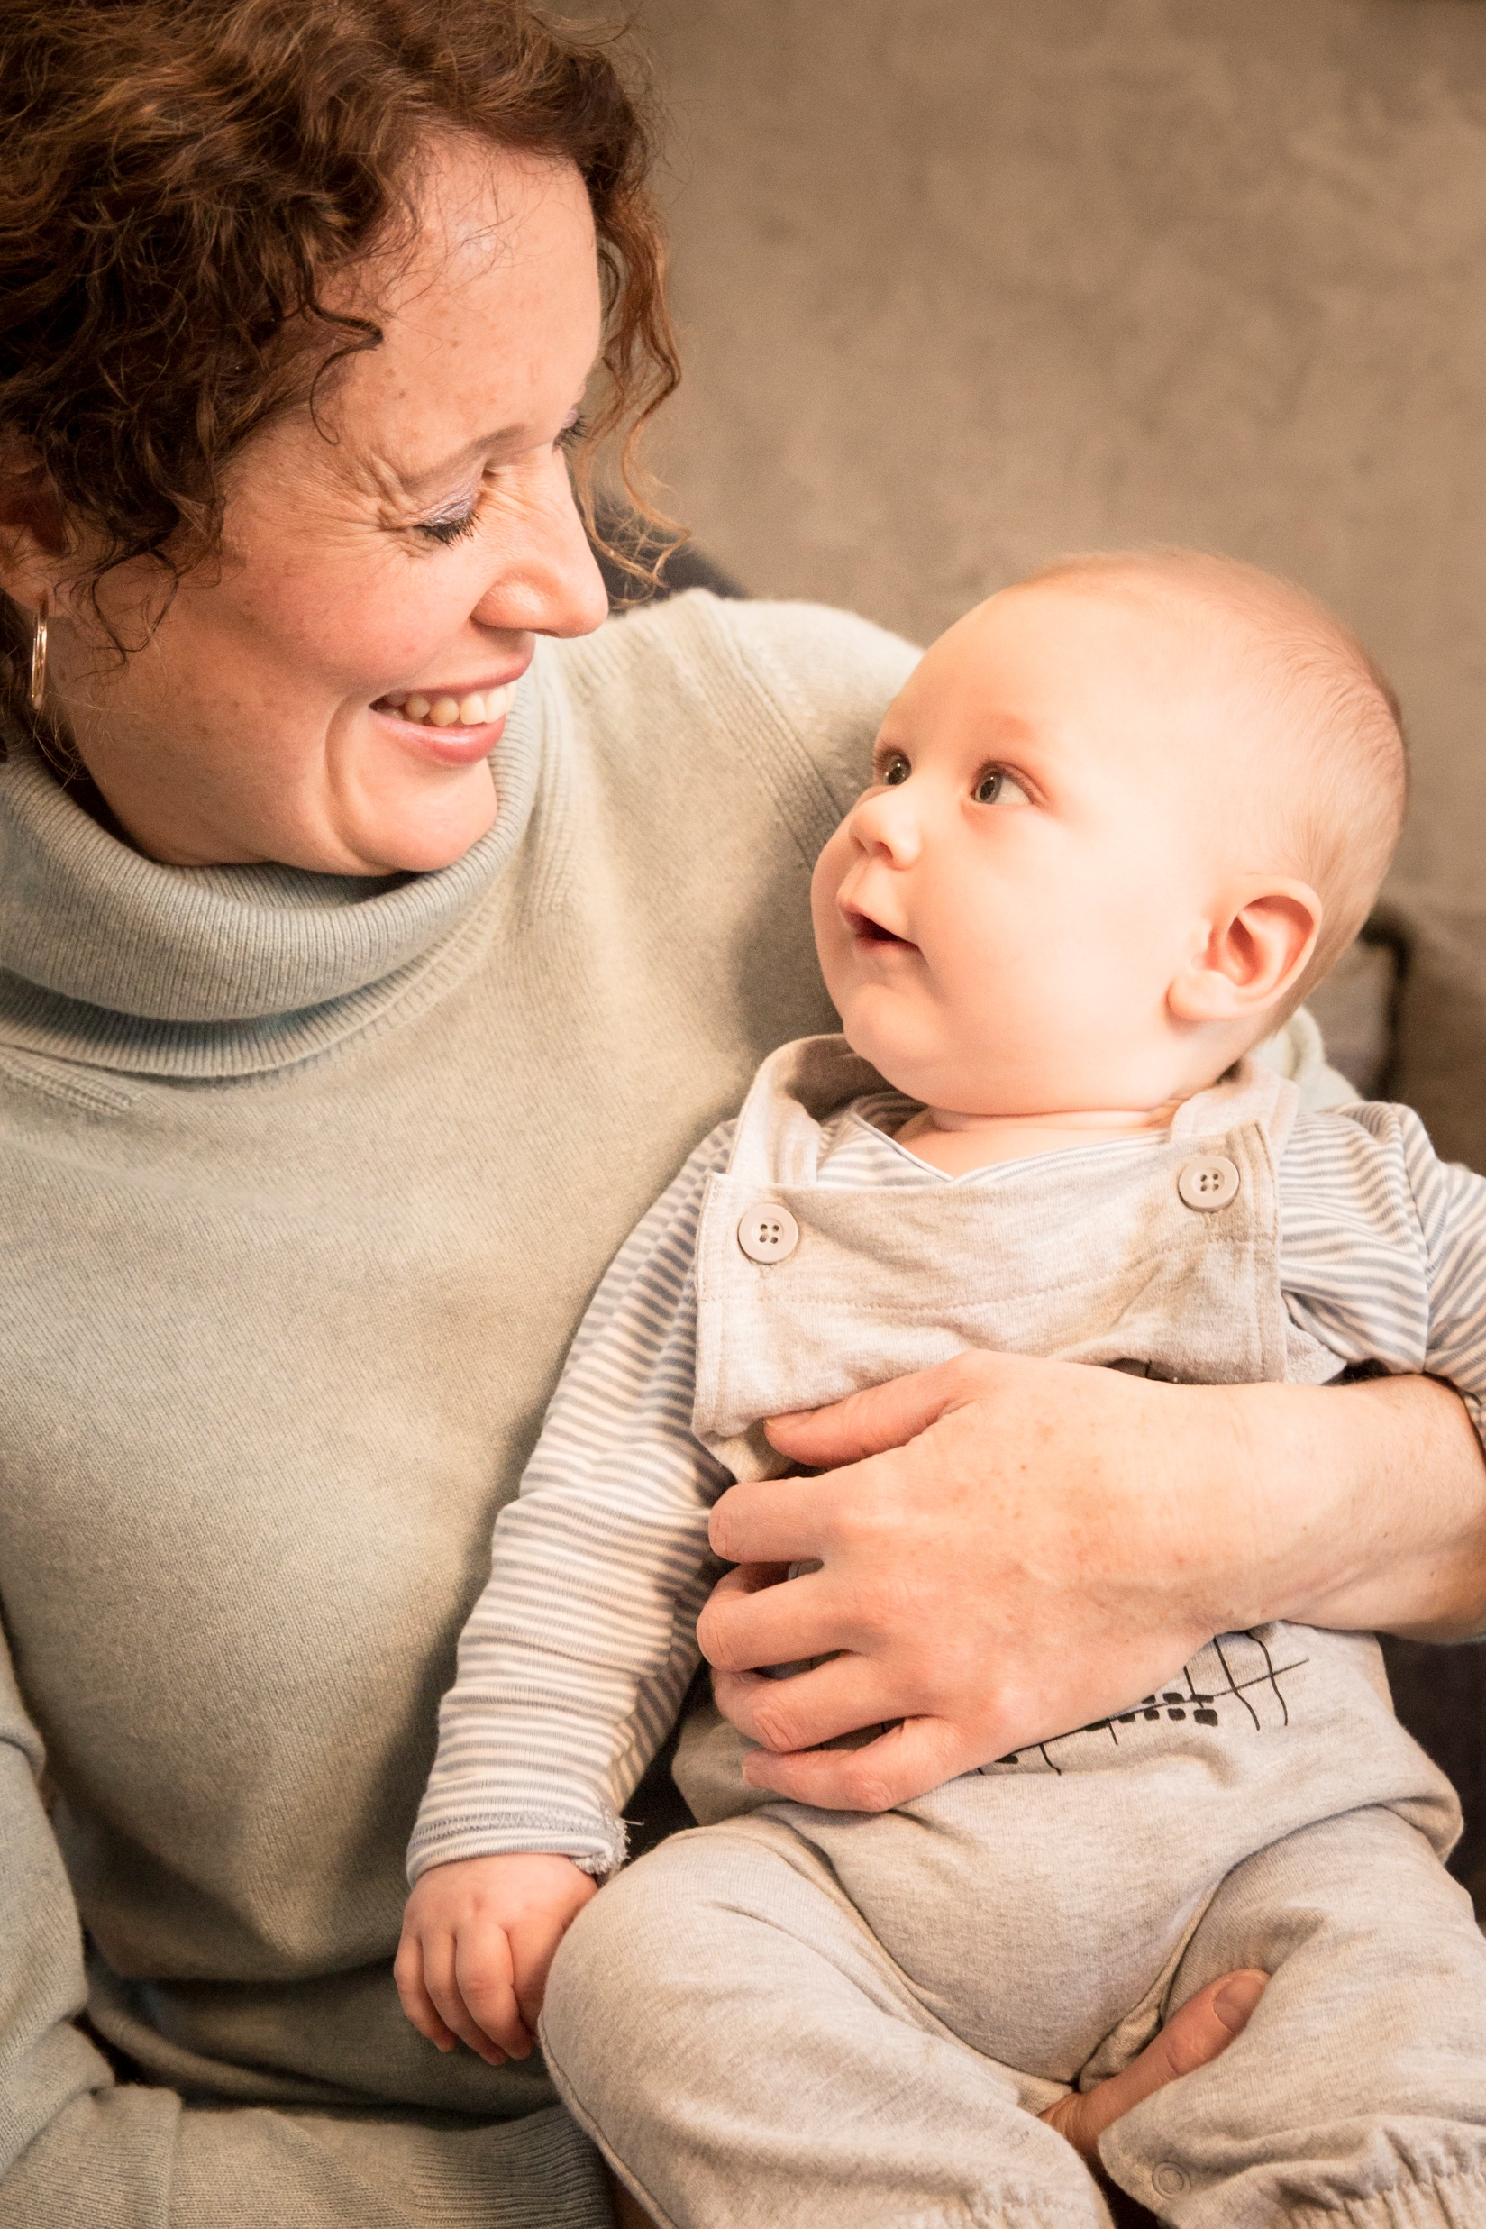
More info
www.cathysage.com
www.firststepsnutritiontrust.org
Very best wishes to you and your little ones

